Slide 1
Parking & Transportation Advisory Committee
Spring ‘25 Update

Slide 2
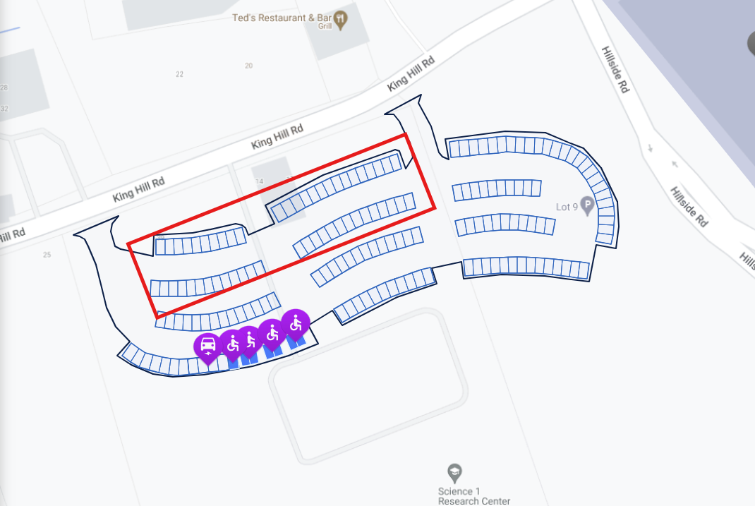
Completed Initiatives
Permit area leveling/redistribution
52 additional Premium Commuter in Lot N Spring ‘25

Slide 3
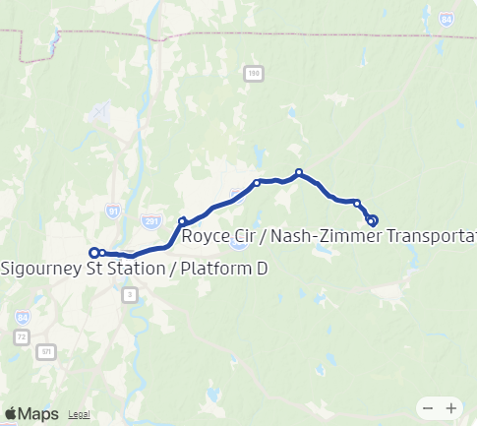
Completed Initiatives
913 Shuttle Capacity Right-sizing
Collaborative effort w/ CTDoT/CT Transit
Capacity added on Mondays/Fridays based on collected data

Slide 4
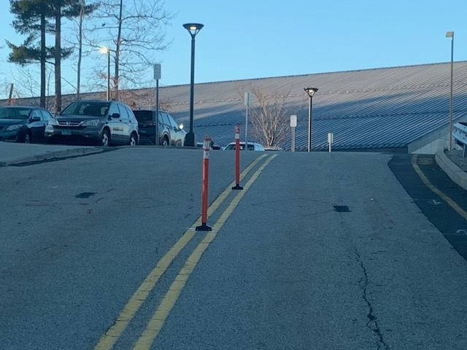
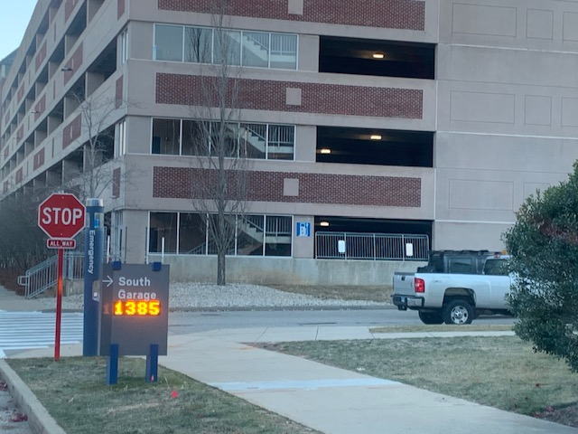
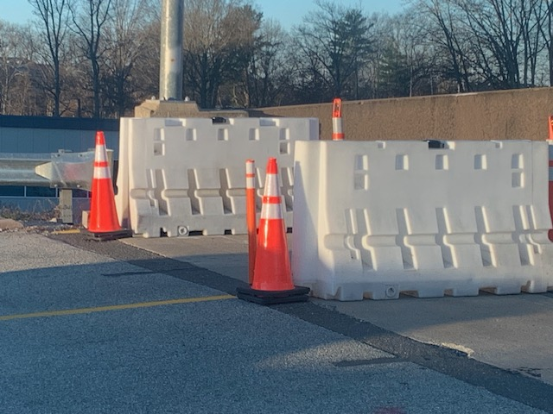
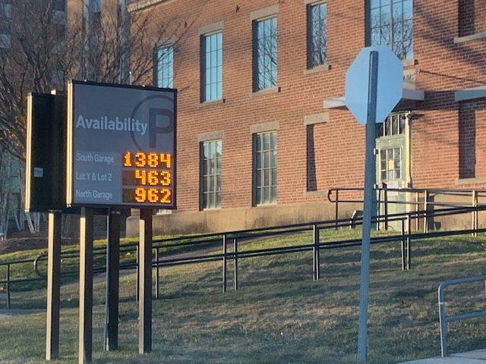
Completed Initiatives
Parking Counting Technology – Lots N, YZ, North Garage, South Garage

Slide 5
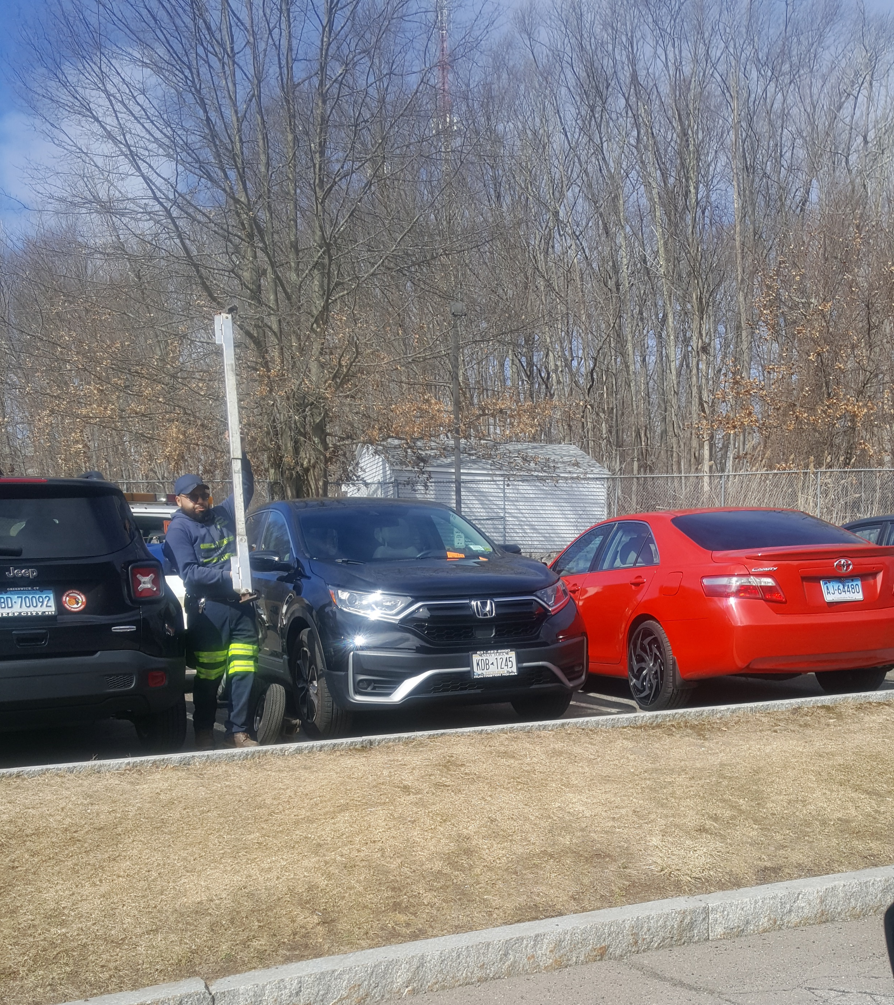
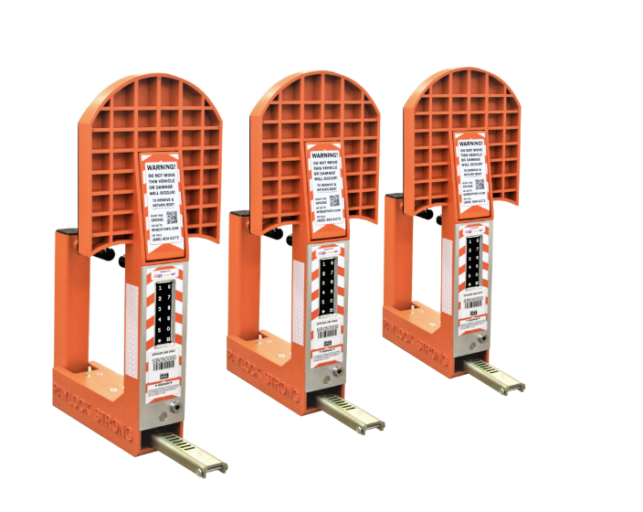
Current Initiatives
Increased escalated parking enforcement
Towing – averaging 5/day
“Paylock Smartboot” (at contracting – so close!)

Slide 6
Current Initiatives

Slide 7
Current Initiatives

Slide 8
Upcoming Parking Infrastructure Re-Investment

Slide 9
Ongoing Challenges
Anticipated Parking Disruptions
Lot S (-~180) through summer ’26 (School of Nursing)
Whitney Rd steam line work: impact to Area 1 streetside parking
Field House Patio and North lot off-line Spring ‘25 - ?

Slide 10
Questions/Discussion?

